Slide 1
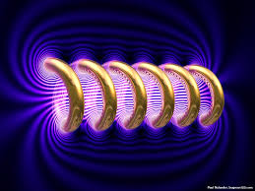
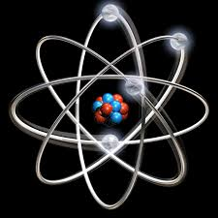

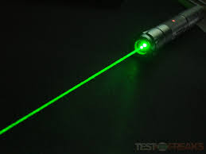


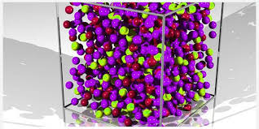
Engineering Physics
PHY-109
Quantum Mechanics-1
ELECTROMAGNETIC THEORY
QUANTUM MECHANICS
LASER
WAVES
Dr. Jeeban Pd Gewali
Department of Physics
Lovely Professional University
Phagwara, Punjab-144411
SOLID STATE PHYSICS
FIBER OPTICS

Slide 2
Syllabus
Need of quantum mechanics, photoelectric effect,
concept of de Broglie matter waves, wavelength of matter waves in different forms.
Heisenberg uncertainty principle, concept of phase velocity and group velocity (qualitative),
Wave function and its significance, Schrodinger time dependent and independent equation
Particle in a box

Slide 3
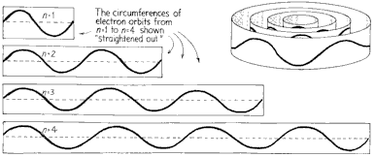
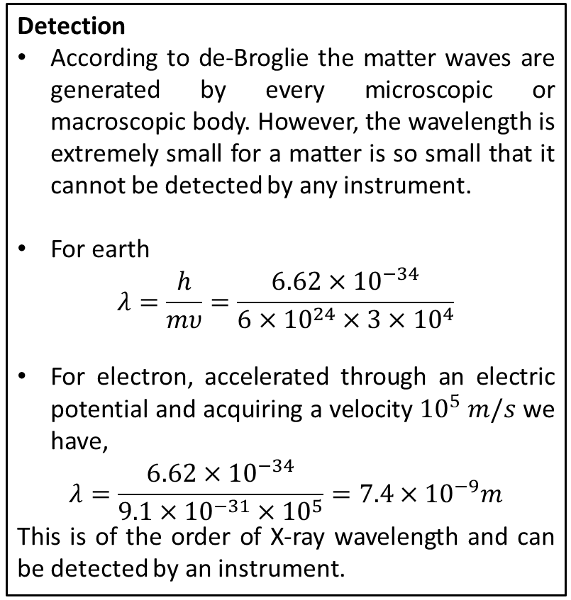
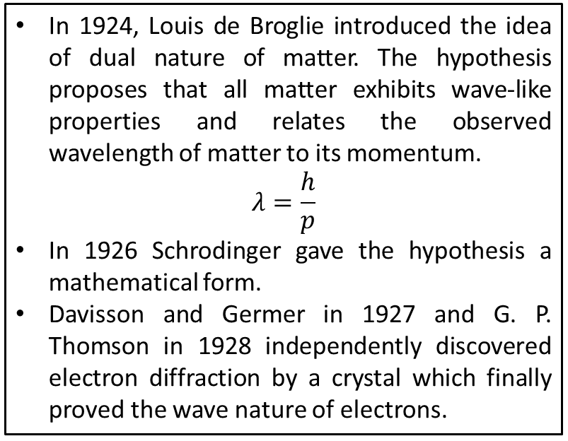
Dual Nature of Matter: de-Broglie Hypothesis
In 1924, Louis de Broglie introduced the idea of dual nature of matter. The hypothesis proposes that all matter exhibits wave-like properties and relates the observed wavelength of matter to its momentum.
$$λ=\frac{h}{p}$$
In 1926 Schrodinger gave the hypothesis a mathematical form.
Davisson and Germer in 1927 and G. P. Thomson in 1928 independently discovered electron diffraction by a crystal which finally proved the wave nature of electrons.
Detection
According to de-Broglie the matter waves are generated by every microscopic or macroscopic body. However, the wavelength is extremely small for a matter is so small that it cannot be detected by any instrument.
For earth
$$λ=\frac{h}{mυ}=\frac{6.62×{10}^{−34}}{6×{10}^{24}×3×{10}^{4}}$$
For electron, accelerated through an electric potential and acquiring a velocity ${10}^{5} m/s$ we have,
$$λ=\frac{6.62×{10}^{−34}}{9.1×{10}^{−31}×{10}^{5}}=7.4×{10}^{−9}m$$
This is of the order of X-ray wavelength and can be detected by an instrument.

Slide 4
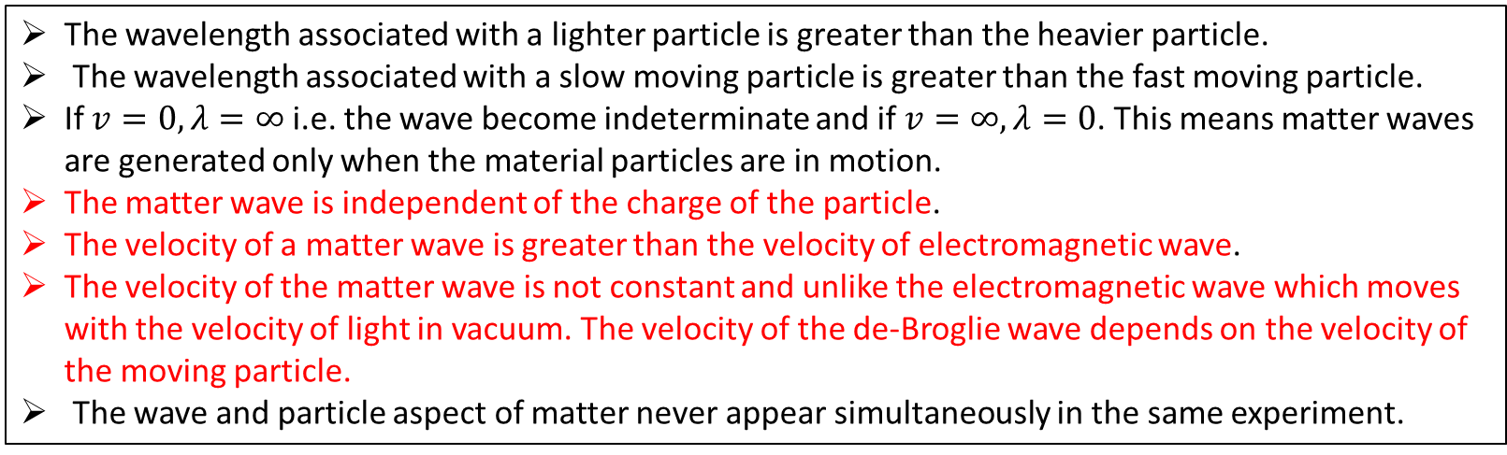
Properties of Matter waves
The wavelength associated with a lighter particle is greater than the heavier particle.
The wavelength associated with a slow moving particle is greater than the fast moving particle.
If $v=0, λ=∞$ i.e. the wave become indeterminate and if $v=∞, λ=0$. This means matter waves are generated only when the material particles are in motion.
The matter wave is independent of the charge of the particle.
The velocity of a matter wave is greater than the velocity of electromagnetic wave.
The velocity of the matter wave is not constant and unlike the electromagnetic wave which moves with the velocity of light in vacuum. The velocity of the de-Broglie wave depends on the velocity of the moving particle.
The wave and particle aspect of matter never appear simultaneously in the same experiment.
The red marked points confirms that de-Broglie waves are not electromagnetic waves.

Slide 5
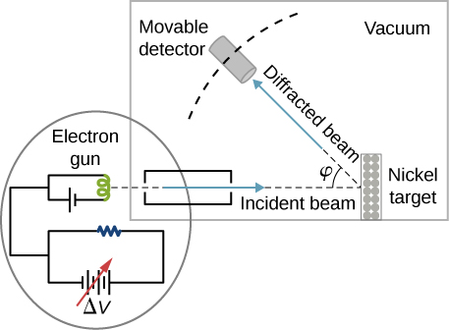
Davisson-Germer Experiment
The Davisson-Germer experiment demonstrated the wave nature of the electron, confirming the earlier hypothesis of de-Broglie. Putting wave-particle duality on a firm experimental footing, it represented a major step forward in the development of quantum mechanics. The Bragg law for diffraction had been applied to x-ray diffraction, but this was the first application to particle waves.
Davisson and Germer designed and built a vacuum apparatus for the purpose of measuring the energies of electrons scattered from a metal surface. Electrons from a heated filament were accelerated by a voltage and allowed to strike the surface of nickel metal.
The electron beam was directed at the nickel target, which could be rotated to observe angular dependence of the scattered electrons. Their electron detector (called a Faraday box) was mounted on an arc so that it could be rotated to observe electrons at different angles. It was a great surprise to them to find that at certain angles there was a peak in the intensity of the scattered electron beam. This peak indicated wave behavior for the electrons, and could be interpreted by the Bragg’s law to give values for the lattice spacing in the nickel crystal.
http://hyperphysics.phy-astr.gsu.edu/hbase/quantum/DavGer2.html

Slide 6
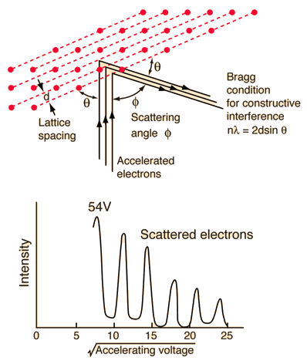
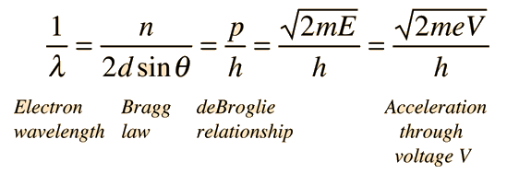


Davisson-Germer Experiment
The experimental data above, reproduced above Davisson's article, shows repeated peaks of scattered electron intensity with increasing accelerating voltage. This data was collected at a fixed scattering angle. Using the Bragg law, the de-Broglie wavelength expression, and the kinetic energy of the accelerated electrons gives the relationship
In the historical data, an accelerating voltage of 54 volts gave a definite peak at a scattering angle of 50°. The angle theta in the Bragg law corresponding to that scattering angle is 65°, and for that angle the calculated lattice spacing is 0.091 nm. For that lattice spacing and scattering angle, the relationship for wavelength as a function of voltage is empirically
$$n=2d sinθ$$
Trying this relationship for n=1,2,3 gives values for the square root of voltage 7.36, 14.7 and 22, which appear to agree with the first, third and fifth peaks above

Slide 7
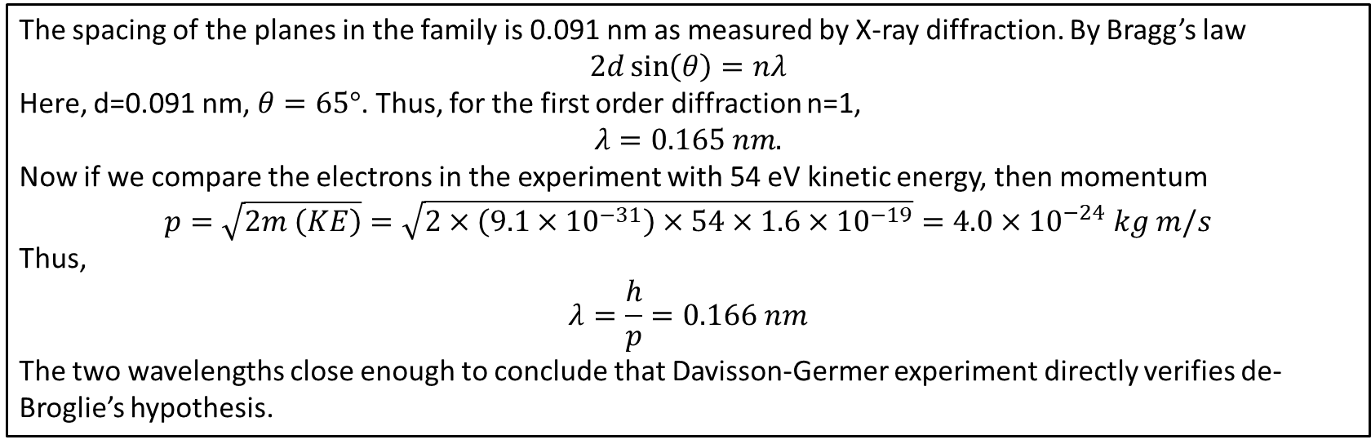
Davisson-Germer Experiment: Verification
The spacing of the planes in the family is 0.091 nm as measured by X-ray diffraction. By Bragg’s law
$$2d\sin\left(θ\right)=nλ$$
Here, d=0.091 nm, $θ=65°$. Thus, for the first order diffraction n=1,
$$λ=0.165 nm.$$
Now if we compare the electrons in the experiment with 54 eV kinetic energy, then momentum
$$p=\sqrt{2m \left(KE\right)}=\sqrt{2×\left(9.1×{10}^{−31}\right)×54×1.6×{10}^{−19}}=4.0×{10}^{−24} kg m/s$$
Thus,
$$λ=\frac{h}{p}=0.166 nm$$
The two wavelengths close enough to conclude that Davisson-Germer experiment directly verifies de-Broglie’s hypothesis.

Slide 8
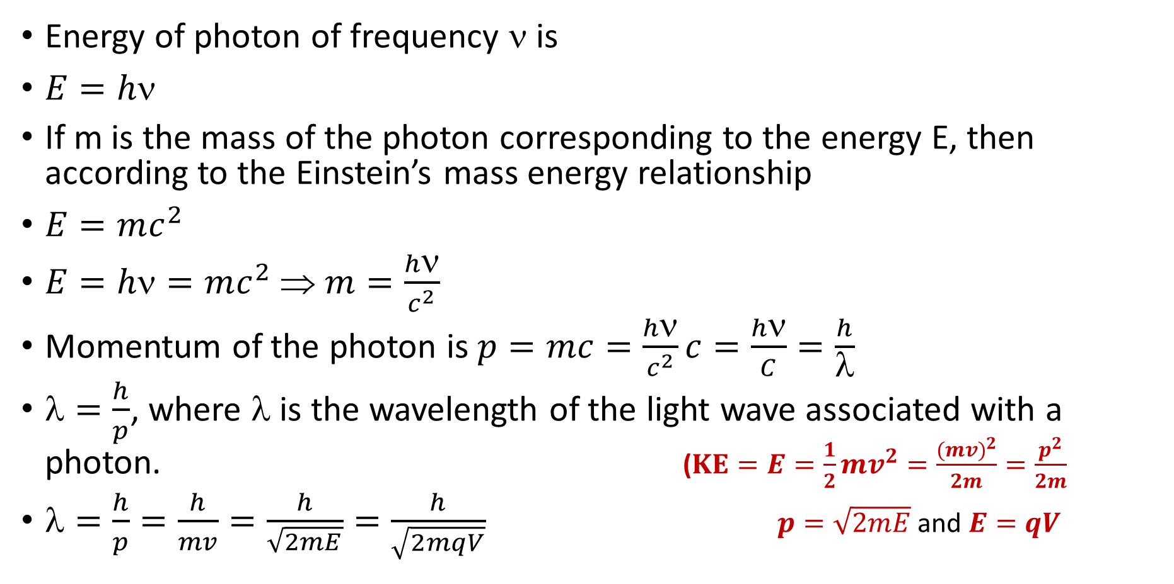
Derivation of de Broglie wave or matter wave
Energy of photon of frequency ν is
$E=h\text{ν}$
If m is the mass of the photon corresponding to the energy E, then according to the Einstein’s mass energy relationship
$E=mc^{2}$
$E=h\text{ν}=mc^{2}$⇒ $m=\frac{h\text{ν}}{c^{2}}$
Momentum of the photon is $p=mc=\frac{h\text{ν}}{c^{2}}c=\frac{h\text{ν}}{C}=\frac{h}{λ}$
$=\frac{h}{p}$, where $$ is the wavelength of the light wave associated with a photon. ($KE=E=\frac{1}{2}mv^{2}=\frac{{(mv)}^{2}}{2m}=\frac{p^{2}}{2m}$
$=\frac{h}{p}=\frac{h}{mv}=\frac{h}{\sqrt{2mE}}=\frac{h}{\sqrt{2mqV}}$$p=\sqrt{2mE}$ and $E=qV$

Slide 9
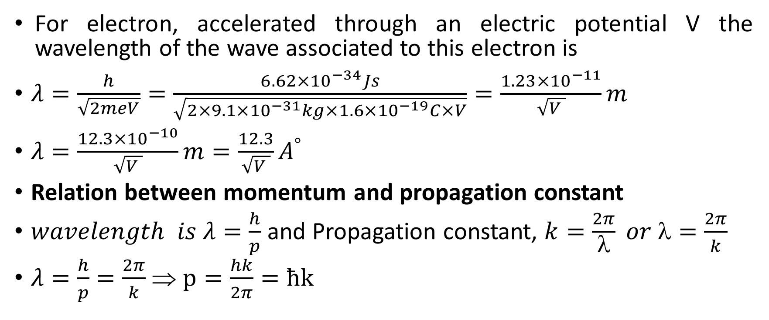
Derivation of de Broglie wave or matter wave
For electron, accelerated through an electric potential V the wavelength of the wave associated to this electron is
$λ=\frac{h}{\sqrt{2meV}}=\frac{6.62×{10}^{−34}Js}{\sqrt{2×9.1×{10}^{−31}kg×1.6×{10}^{−19}C×V}}=\frac{1.23×{10}^{−11}}{\sqrt{V }}m$
$λ=\frac{12.3×{10}^{−10}}{\sqrt{V }}m=\frac{12.3}{\sqrt{V }}A^{°}$
Relation between momentum and propagation constant
$wavelength is λ=\frac{h}{p}$ and Propagation constant, $k=\frac{2π}{λ} or λ=\frac{2π}{k}$
$λ=\frac{h}{p}=\frac{2π}{k}$⇒ $p=\frac{hk}{2π}=ћk$

Slide 10
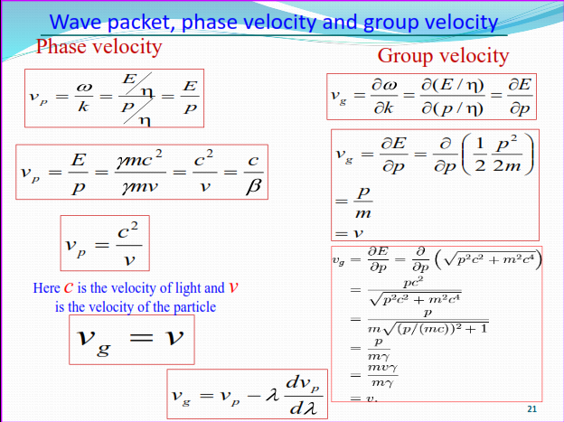

Slide 11
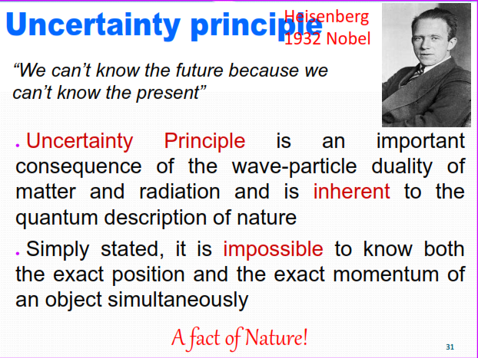

Slide 12
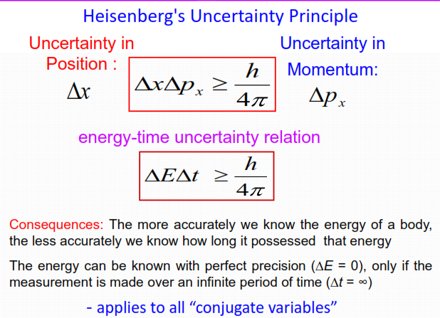

Slide 13
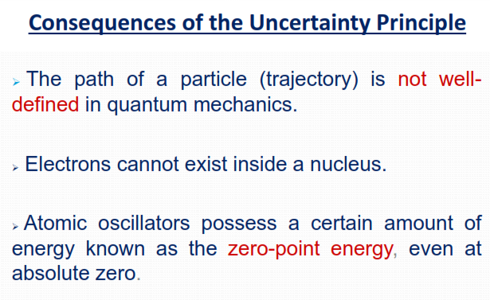

Slide 14
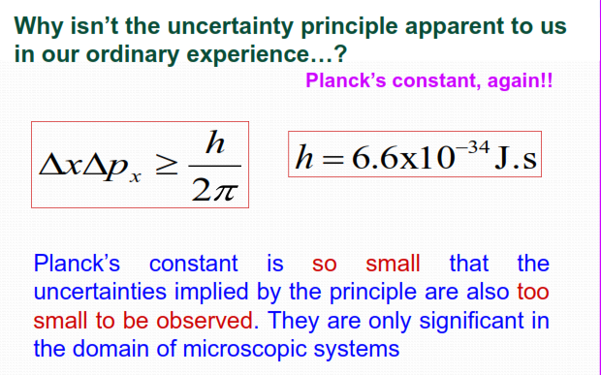

Slide 15
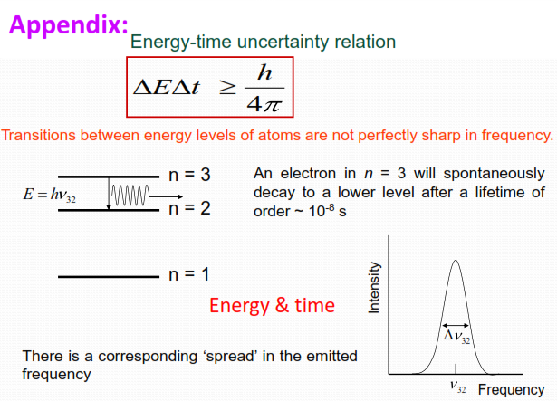

Slide 16
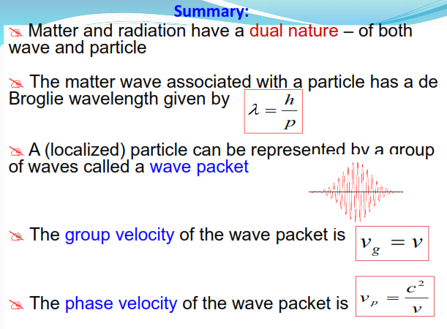

Slide 17
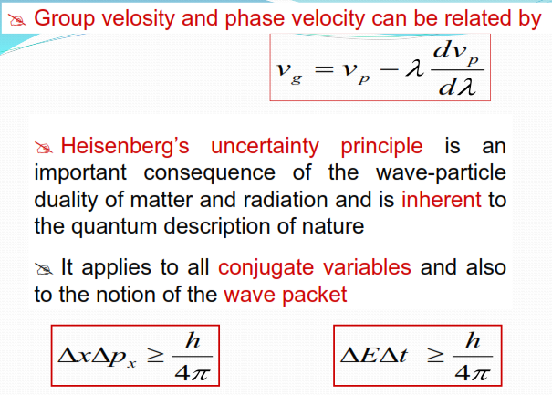

Slide 18
